Slide 1
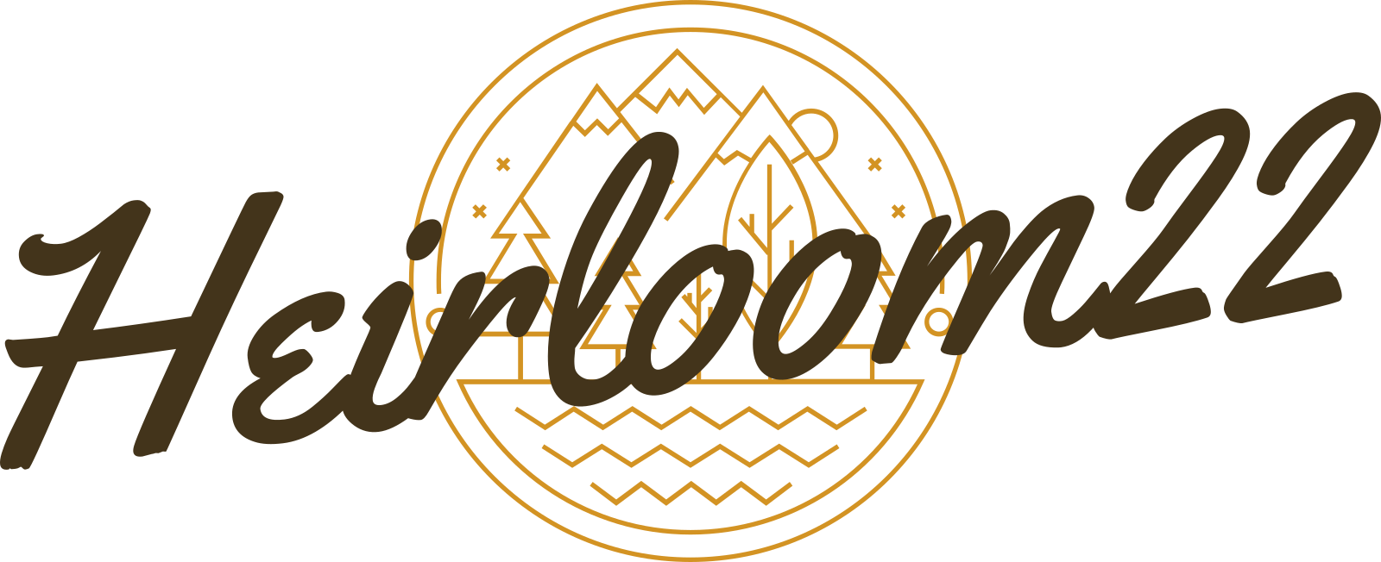
team C.A.L.L.
Chuan.Anqi.Luoming.Lawson.
Notes:
(30 sec) Introduce team and their roles. Mention supervisor. Identify client.

Slide 2
The Client
Who is the Client?
Low technological literacy
Older users
Motivations
Want to learn about family artefacts and family history
Want to preserve stories for future generations
Frustrations
Can’t keep track of the stories of many artefacts
Existing tools are tedious and not suitable for task
Notes:
(30 sec) Go over this stuff pretty quickly

Slide 3
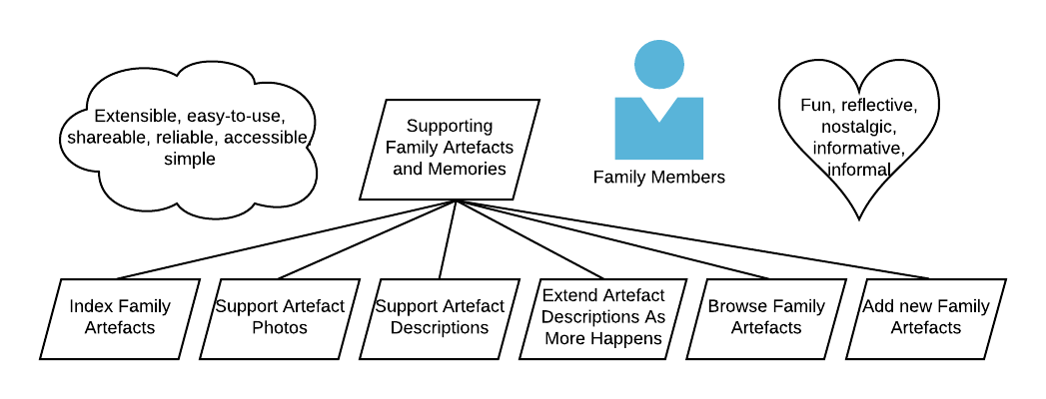
Requirements
A collection of artefacts
Maintain
Explore
Learn
Extend
Secure
Family access
Minimize tedium:
Just want to work with the stories
Add as little or as much info as you want
Notes:
(2min30sec) Go into some detail on each point: Collection:
Maintain collection - add, edit, remove information
Explore - a way to explore artefacts and discover stories
Learn - a way to learn the stories of specific artefacts
Extend - artefacts are important not because of one important moment, but many throughout history.
(Say the following to introduce Chuan)
(Also show the next slide)
None of the requirements would have been meet if we did not have a clear forms of communication with in the team.

Slide 4




Technology and Tools

Slide 5
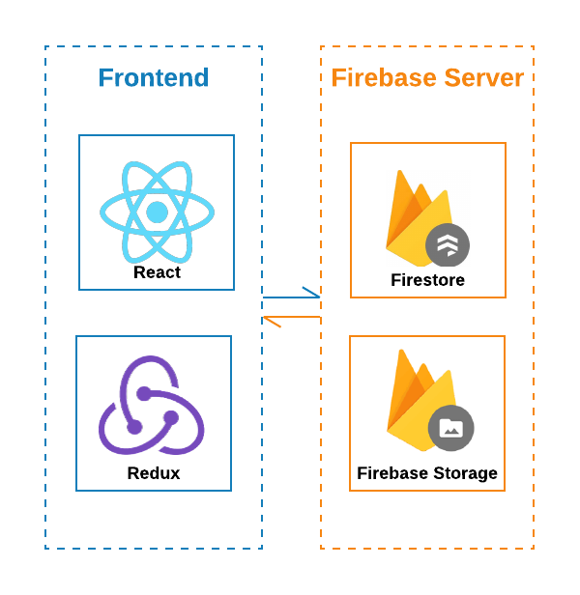
Technology and Tools
Criteria
Web based
Fast development
Secure
Notes:
To code are mainly written in Javascript
1
Because we were designing a web app, we used React and Redux that runs well in most browsers
2
Because we follow a fast agile process we needed a framework that can be deployed and tested as soon as possible. Firebase provided database and storage as service. Which means we were able focus on the front end development. Since Firestore is a NoSQL database, we were able to quickly test out different schemas.
3
Lastly
We chose Firebase because it provides highly secure authentication service that meets our client’s standard.

Slide 6
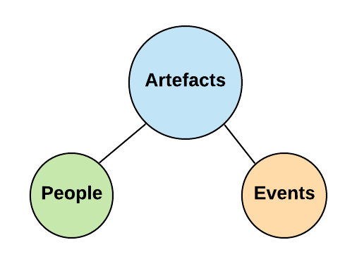
Technology and Tools
Database Model
Notes:
To code are mainly written in Javascript
1
Because we were designing a web app, we used React and Redux that runs well in most browsers
2
Because we follow a fast agile process we needed a framework that can be deployed and tested as soon as possible. Firebase provided database and storage as service. Which means we were able focus on the front end development. Since Firestore is a NoSQL database, we were able to quickly test out different schemas.
3
Lastly
We chose Firebase because it provides highly secure authentication service that meets our client’s standard.

Slide 7
Live Demo!

Slide 8
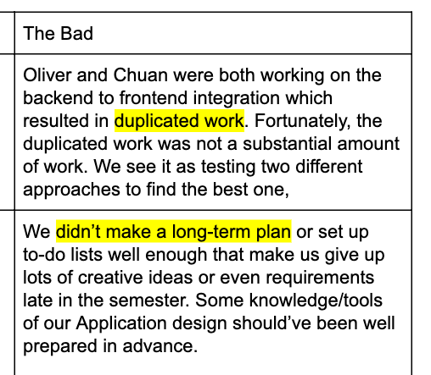
Afterward: Lessons Learned
Excerpt from Sprint 2 Retrospective
Notes:
At the end of sprint 2 it became apparent that we needed a better method of communication
Oliver and I were working independent from each other it lead to duplicated work
Part of the reason for duplicated work is that we often work independent from each other.
We have a goal but no long term plan and to do list to support the goal. Often we would try to come up with new features on our own without consulting other team members.
So This was the mid semester break and the frontend and backend weren’t integrated. We were still serving static HTML. Something had to be done

Slide 9
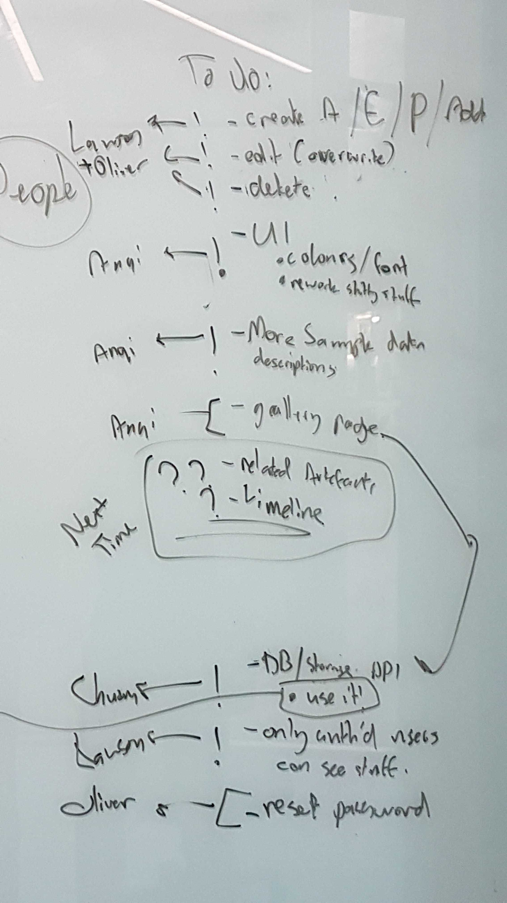
Afterward: Lessons Learned
What did we change?
Weekly Meeting
Weekly sprint
Excerpt from the Mid Semester Break Meeting
Notes:
First thing we did was to write down everything we needed in each weekly meeting
Meeting in person helped us to flush out ideas and keep each other on the same page

Slide 10
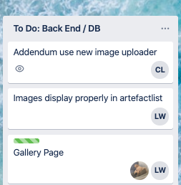
Afterward: Lessons Learned
What did we change?
Weekly Meeting
Weekly sprint
Use Trello
Assign tasks
Excerpt from Trello
Notes:
When we finalized what to do, we then break down each big tasks into smaller tasks
Here you can see that the Image is break in many sections.
Since both tasks are related to Image, it might be confusing to figure out who is do what.
On Trello it is clear to see that
The part related to Addendum was assigned to CL
The part related to ArtefactList was assigned to LW
Of course there are times when we just started a task and didn’t possess the knowledge to break the tasks down.When this happened we created a big tasks and assigned multiple people to it. We then; created smaller tasks as we progressed

Slide 11
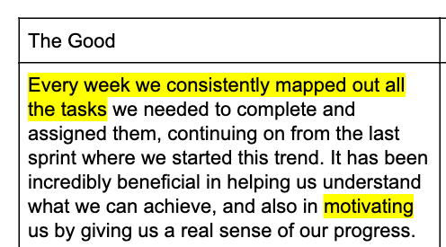
Afterward: Lessons Learned
Excerpt from Sprint 3 Retrospective
Notes:
As you can see from our demo, the changes to the team worked.
As documented in the sprint 3 retrospective, not only was the the process consistent, it also motivated us by showing us our progress and reminding us what needs to be done.

Slide 12
Thanks for listening!

